Slide 1
Linux Essentials
Using kali linux

Slide 2
-1- man
-2- ls
-3- cd
-4- cp
-5- mv
-6- mkdir
-7- rmdir
-8- rm
-9- touch
-10- locate
-11- find
-12- grep

Slide 3
-13- sudo
-14- df
-15- du
-16- head
-17- tail
-18- tar
19-chmod
20- chown
-21- ps
-22- kill
-23- wget
-24- curl

Slide 4
-25- top
-26- htop
-27- pwd
-28- zip
-29- unzip
-31- echo
-32- useradd
-33- userdel

Slide 5
Linux Permissions
Using kali linux

Slide 6
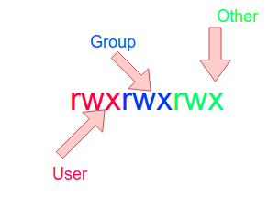

Slide 7
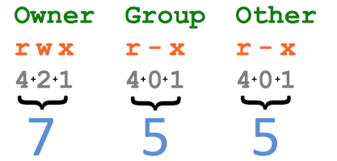

Slide 8
Linux Install Software
Using kali linux

Slide 9
apt-cache search software
apt-get autoremove software
apt-get install software

Slide 10
Encryption Essentials

Slide 11
Symmetric Encryption vs. Asymmetric Encryption
AES , DES , TWOFISH , Caesar Cipher

Slide 12
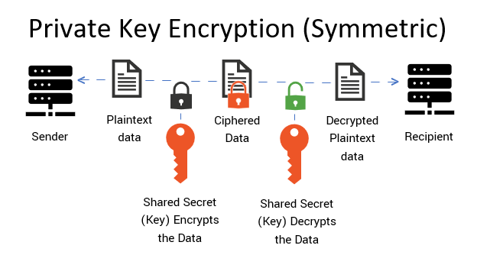
Symmetric Encryption vs. Asymmetric Encryption

Slide 13
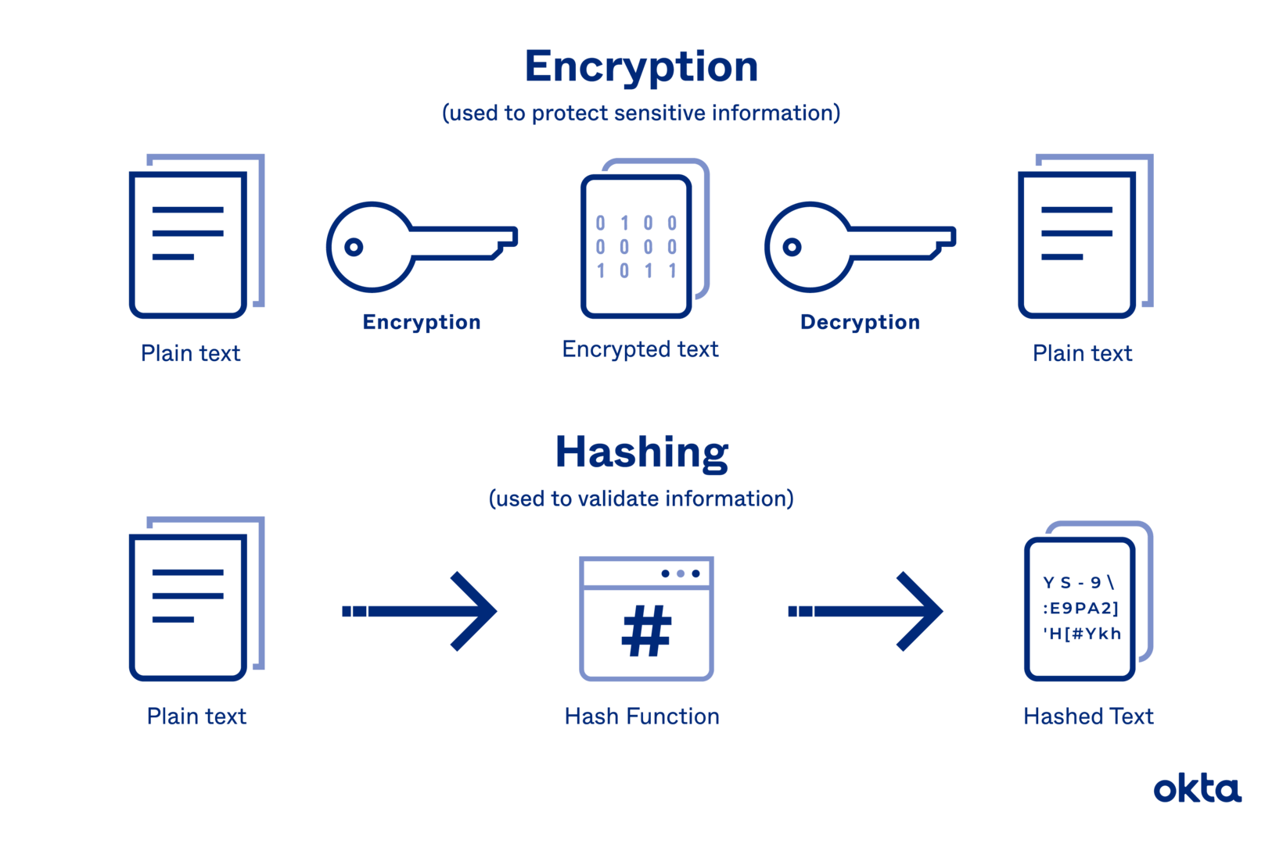
HASH
MD5 , SHA 256

Slide 14
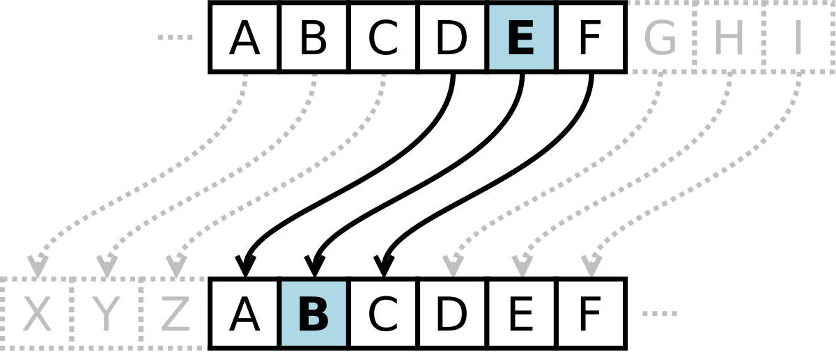
Encoding

Slide 15
Network Essentials

Slide 16
OSI
Open Systems Interconnection

Slide 17
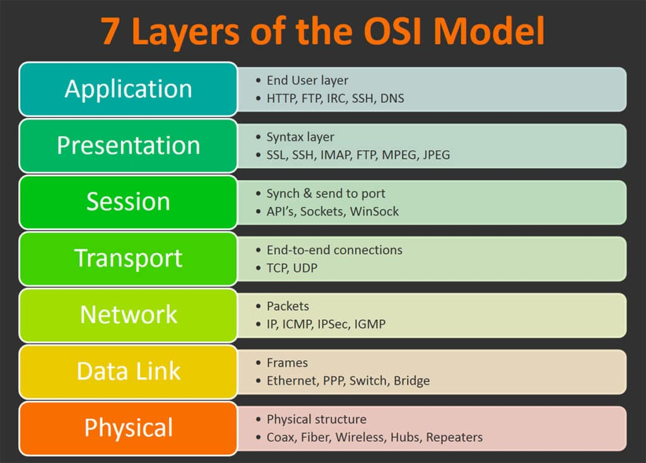

Slide 18
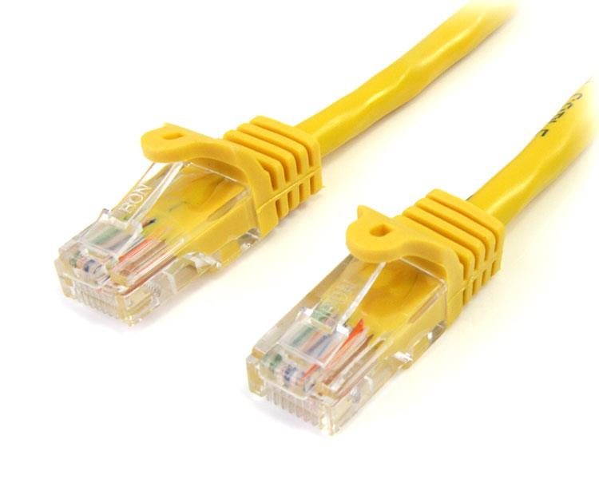
Physical Layer
RJ-45
RJ-11

Slide 19
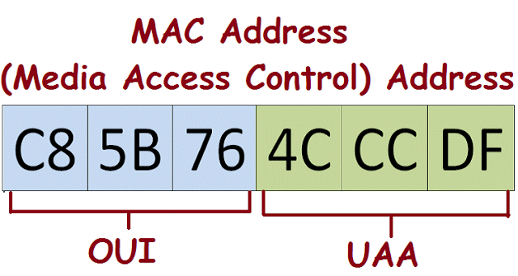
Data Link Layer
48 Bit

Slide 20
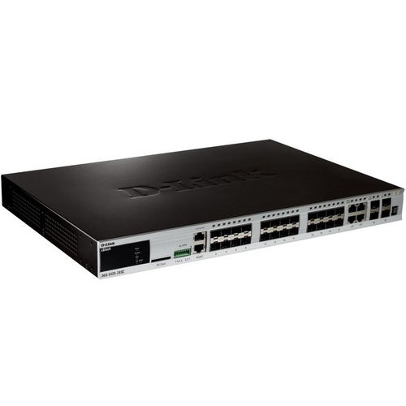
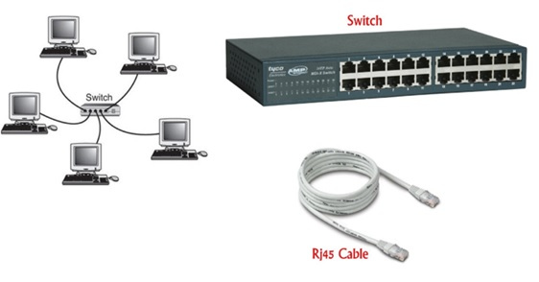
Data Link Layer

Slide 21
Network Layer
IP V4 DHCP NAT

Slide 22
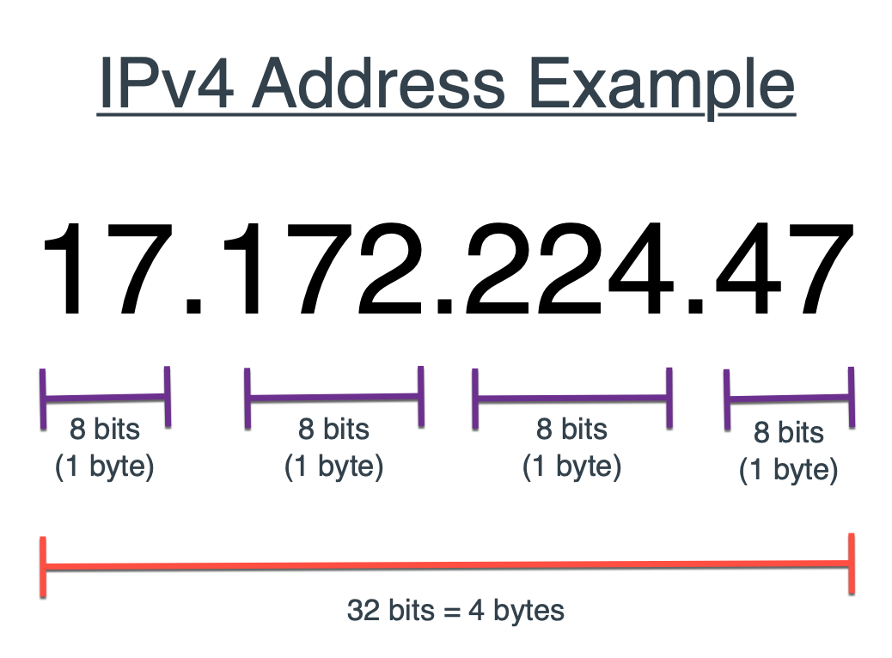
Network Layer

Slide 23
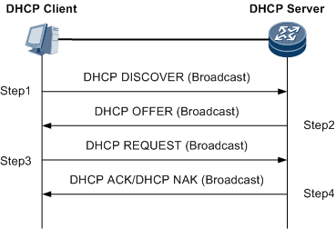
Network Layer
DHCP and netmask

Slide 24
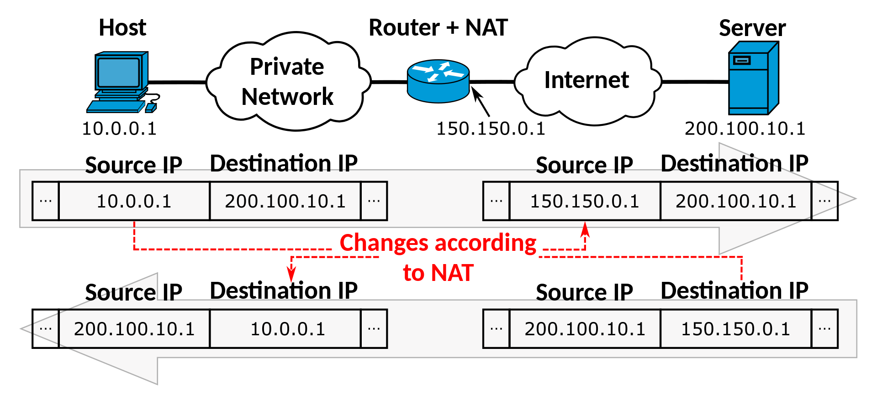
Network Layer

Slide 25
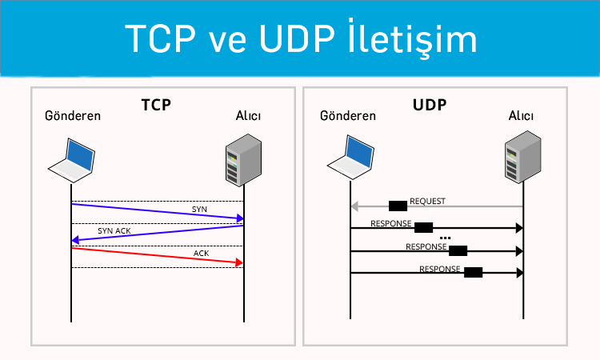
Transport Layer

Slide 26
Transport Layer
TCP = Transmission Control Protocol
UDP = User Datagram Protocol

Slide 27
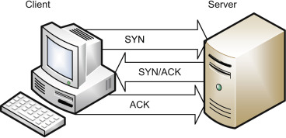
Transport Layer
TCP = Transmission Control Protocol

Slide 28
Transport Layer
PORTS
HTTP – Port 80.
HTTPS – 443.
FTP – 21.
FTPS / SSH – 22.
POP3 – 110.
POP3 SSL – 995.
IMAP – 143.
IMAP SSL – 993.

Slide 29
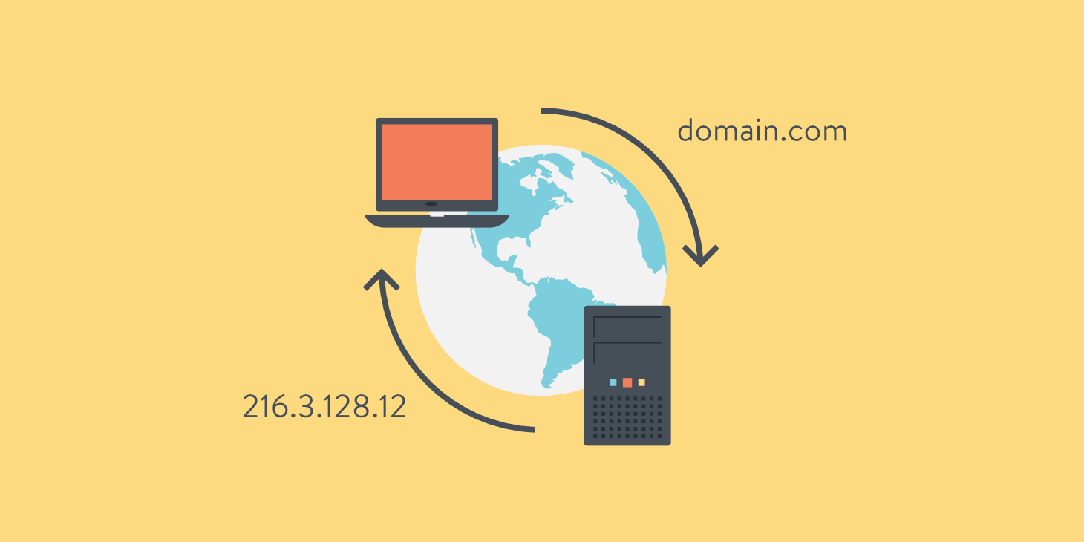
5 & 6 Layer
DNS = Domain Name System

Slide 30
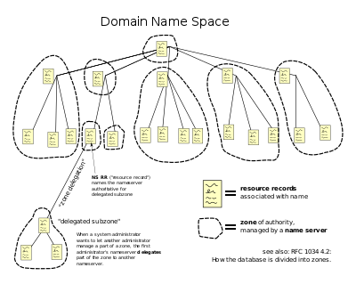
DNS

Slide 31
HTTP vs HTTPS
HTTP = Hypertext Transfer Protocol , 80
HTTPS = Hypertext Transfer Protocol Secure , 443

Slide 32

HTTP vs HTTPS
What Is a Certificate Authority (CA)?

Slide 33
HTTP vs HTTPS
HTTPS = Hypertext Transfer Protocol Secure , 443
CRL: What Is a Certificate
Revocation List?
What Is a OCSP ?

Slide 34
What Happens When You Type google.com

Slide 35
Concat With Me:
Facebook: Abdulrahman Maktabi
Twitter: https://twitter.com/cholalien__
Github: https://github.com/AbdulrahmanMaktabi
Codepin: https://codepen.io/cholalien__
My WebSite: 404 Not Found !

